Slide 1
Learning & Development Enabling development, Impacting growth…
Cognos 11 (IBM Cognos Analytics) – Training
Introduction to Cognos

Slide 2
Module Objectives :
Why Reporting?
Why Cognos Analytics?
Cognos 8/10 and 11 Comparison
Cognos Analytics Self Service capability
Cognos Analytics - Three tier Architecture
User Interfaces
Web-based User Interfaces
Tier 1 Web Server: Cognos Analytics Gateways
Tier 2 Application: Cognos Analytics Servers
Tier 3 Data: Content Providers
Accessing Cognos Analytics

Slide 3
Why Reporting?
Business Intelligence (BI) applications enable businesses to gather, store, analyze, integrate, and present business data.
Better Decision Making
Reporting and Analysis of BI data enables businesses to make better and efficient decisions.
Efficient Management
Provides historical, current and future business operations data that enable to manage businesses efficiently.
Quality Data
BI applications use data stored in a data warehouse or data mart..
Software Element Support
Software elements support the use of this information by assisting in the extraction, analysis, and reporting of information.

Slide 4
Why Cognos Analytics?
Introduction
IBM Cognos Analytics is a complete enterprise business intelligence solution with a range of BI capabilities.
Enables users to author, share, and use reports that retrieve data from all enterprise sources which helps to take efficient business decisions
Use reports, analysis, dashboards and scorecards to monitor business performance, analyze trends and measure results.
Easy to deploy and manage due to a Service Oriented Architecture (SOA).
Scalability to handle a large number of users.
Modular deployment enables you to meet immediate user requirements and expand or modify as needed.

Slide 5
Why Cognos Analytics? - Features and Benefits
Reporting
Provides access to a complete list of self-serve report types, is adaptable to any data source and operates from a single metadata layer for a variety of benefits such as multilingual reporting, ad hoc query, and scheduling and bursting.
Analysis
Enables the guided exploration of information that pertains to all dimensions of your business, regardless of where the data is stored. Analyze and report against online analytical processing (OLAP) and dimensionally aware relational sources.
Dashboards
Business dashboards communicate complex information quickly. They translate information from your various corporate systems and data into visually rich presentations using gauges, maps, charts and other graphical elements to show multiple results together.
Scorecarding
Enables you to align your teams and tactics with strategy, communicate goals consistently, and monitor performance against targets.

Slide 6
Cognos Analytics Self Service capability
Basic data modeling, coupled with an updated look and feel
Create an attractive dashboard in minutes
As data is dragged onto the canvas, Cognos selects a visualization to best
represent it
Automatically linking of a filter across the object
The graphs and tables are laid out on a choice of grids which enhances
the visual appeal without any additional effort by users

Slide 7
Cognos Analytics - Three tier Architecture
The Cognos Analytics BI architecture consists of the following features:
Single, open Application Program Interface (API) founded on SOAP and XML.
Enables integration with Microsoft Office, Business Performance Management (BPM) solutions, enterprise search capabilities, and other applications.
Consistent, zero foot print web based user interface.
Supports leading Relational Databases as well as OLAP.
Ensures dynamic load balancing.
Cognos can be customized and is compatible with third party product.
Supports multilingual reporting.
Notes:
7

Slide 8
IBM Cognos Analytics - Three tier Architecture
BUSINESS INSIGHT
BUSINESS INSIGHT
ADVANCED
REPORT STUDIO
METRIC STUDIO
FRAMEWORK MANAGER
OTHER STUDIOS
WINDOWS AND WEB BASED INTERFACES
NETWORK FIREWALL
WEB GATEWAY
TIER 1: WEB SERVER
NETWORK FIREWALL
LDAP
COGNOS ACCESS MANAGER
CONTENT MANAGER
DISPATCHER
TIER 2: APPLICATION
NETWORK FIREWALL
CONTENT STORE
METRIC STORE
QUERY DATABASE
TIER 3: DATA

Slide 9
IBM Cognos Analytics- User Interfaces
Cognos Connection
Cognos Analytics
Web-based tool enabling report authors to create, edit, and distribute a wide range of professional reports. It can also edit or modify reports created in Query Studio or Analysis Studio.
Query Studio
Web-based tool for ad-hoc reporting enabling users with little experience in Cognos to quickly design, create and save reports to meet reporting requirements not covered by the standard, professional reports created in Report Studio.
Analysis Studio
Web-based tool enabling users to explore, analyze, and compare dimensional data. It provides access to dimensional, Online Analytical Processing(OLAP), and dimensionally modeled relational data sources.
Web-based tool to create agents to monitor data and perform tasks when business events or exceptional conditions occur in your data. When an event occurs, users are alerted to take action.
Windows based modeling tool to create and manage business related metadata for analysis and reporting. It provides a single, integrated business view of any number of heterogeneous data sources.
Framework Manager
Event Studio
Web portal provided with Cognos Analytics where users have a single point of access to corporate data. Users can query, analyze and organize data, create reports, scorecards and events

Slide 10
IBM Cognos Analytics BI Architecture
Tier 1: Web Server & Gateways
Tier 1 consists of a Web Server and Gateways through which provides the user session connectivity with various BI applications.
Gateway: It is an extension of the Web Server program that transfers information from one server to another.
Web communication in Cognos Analytics occurs through Gateways, which resides on one or more Web Servers.
The following functionality occurs when Cognos Analytics gateway receives a request:
Encrypts passwords to ensure security.
Extracts information required to submit the request to a Cognos Analytics server and attaches environment variables for the Web server.
Adds a default namespace to the request to ensure that the server authenticates the user in the current namespace.
Transfers requests to a Cognos Analytics dispatcher for processing.
Cognos Analytics supports CGI, ISAPI, Apache_Mod and Servlets as gateways.
Cognos Analytics User Interface
Application Tier
Data Tier
Web server & Gateway Tier

Slide 11
IBM Cognos Analytics BI Architecture
Tier 2: Cognos Application Servers
Tier 2 consists of various components, such as, a Dispatcher, Content manager and Services.
The Cognos Analytics Applications tier can be configured on one or more Cognos Analytics Servers. A Cognos Analytics Server runs requests, such as reports, data analysis and queries that are received through a gateway. A Cognos Analytics server also renders the Cognos Connection and Metric Studio interfaces.
Each Cognos Analytics Application Tier includes the following:
Dispatcher that performs load balancing of requests at the application tier. It is a light weight java servlet that managers application services.
Report Server consists of the report or query service which is mainly responsible for application tier processing.
Content Manager which manages storage of the application data such as packages, report specification, dashboards, server configuration settings, security settings and configuration, metrics and report output
Cognos Analytics User Interface
Application Tier
Data Tier
Web server & Gateway Tier

Slide 12
IBM Cognos Analytics BI Architecture
Tier 3: Data Tier
Tier 3 consists of Content store, Data sources and Metric store
Content store: A relational database that stores data required by Cognos Analytics to operate, such as, report specifications, published models, and packages that contain them; connection information for data sources; information about the external namespace, and the Cognos namespace itself; and information about scheduling and bursting reports.
Data sources: These are relational databases, dimensional cubes, files, or other physical data stores that can be accessed through Cognos Analytics. Application Tier Components use data source connections to access data sources.
Metric store: A Relational database that contains content for metric packages. A metric store also contains Metric Studio settings, such as user preferences.
Cognos Analytics User Interface
Application Tier
Data Tier
Web server & Gateway Tier

Slide 13
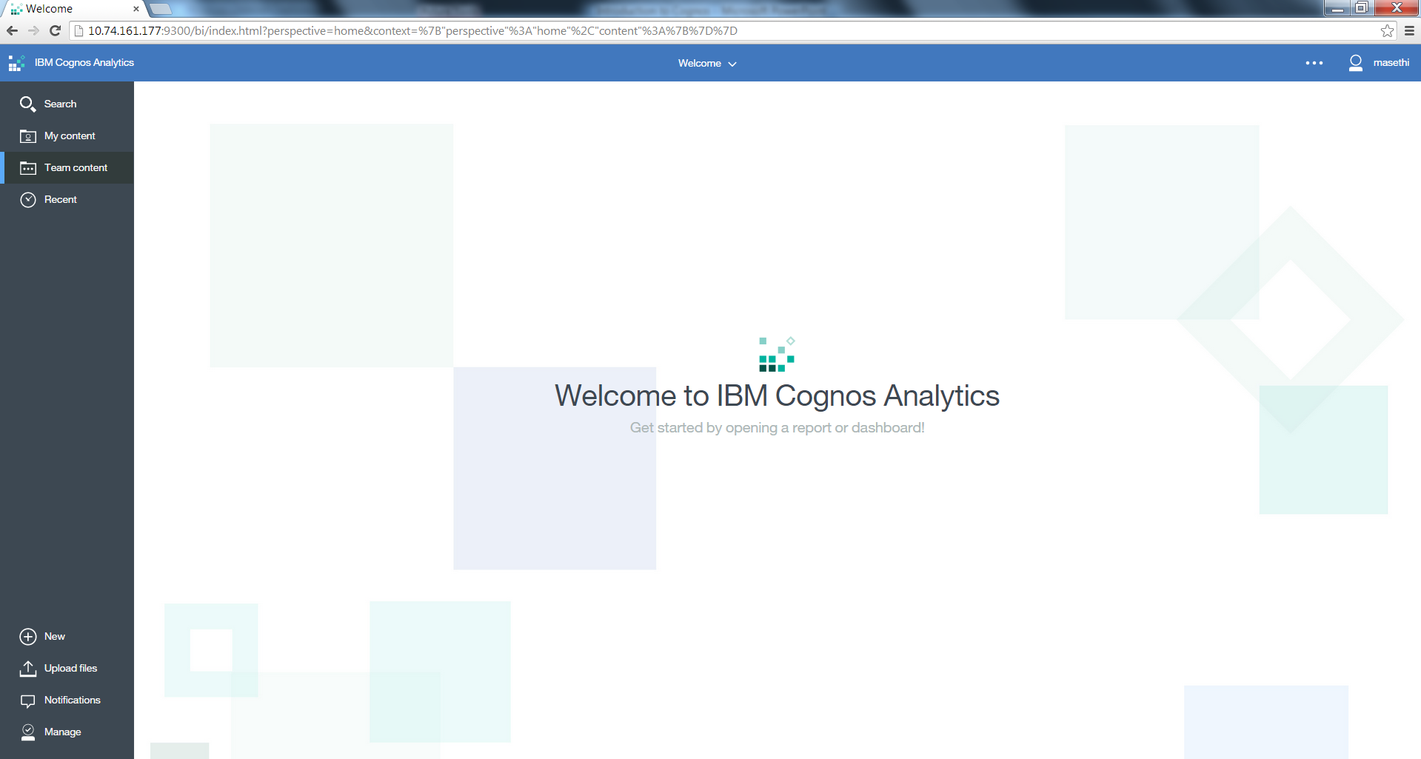
Accessing IBM Cognos Analytics
IBM Cognos Homepage - http://10.74.161.177:9300/bi/v1/disp

Slide 14
Cognos Analytics Workflow
Plan
Manage
Model
Author
Consume
Administer Server & Reports
Setup & Maintain Security
Plan for implementation
Framework Manager Projects
Author Reports/Analyses
Configure
Run, View, Print Report/Analyses
Publish Package
Install

Slide 15
Cognos 8/10 and 11 Comparison

Slide 16
Q & A

Slide 17
Thank You
Review Date | 14-July-2016
Version | 1.0
Next Review Due | 14-July-2017

